Slide 1
Voltiris
Low-Level Software Communication Specifications V1.1 (2023-07-17)

Slide 2
Tracklog
Add-ons from version 1.0:
Change from RTU to ASCII mode

Slide 3
Introduction
Hardware Connectivity
Modbus Protocol
Proposed Modbus Meta Protocol
Slave identification
Option descriptors
Cyber security

Slide 4





Hardware Connectivity [Need to be updated based on MHA feedback]
1-16 devices
RS-485 + power
RS-485 + power
< 1.6m
PoE++

Slide 5
Modbus Protocol
Standard developed by Schneider Electric in 1979
Optimal for low-speed / low-bandwidth
Can run under different hardware layers (serial, ethernet, etc)
Client / server protocol (up to 247 devices)
Capability of broadcasting (address 0)
Not secured against unauthorized commands or interception of data

Slide 6
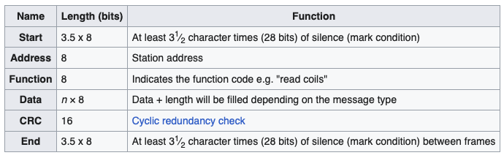
Modbus Commands
Modbus commands can instruct a Modbus device to:
Read / write the value of one register
Read I/O port
Modbus frame format:
Pseudo-binary RTU / ASCII

Slide 7
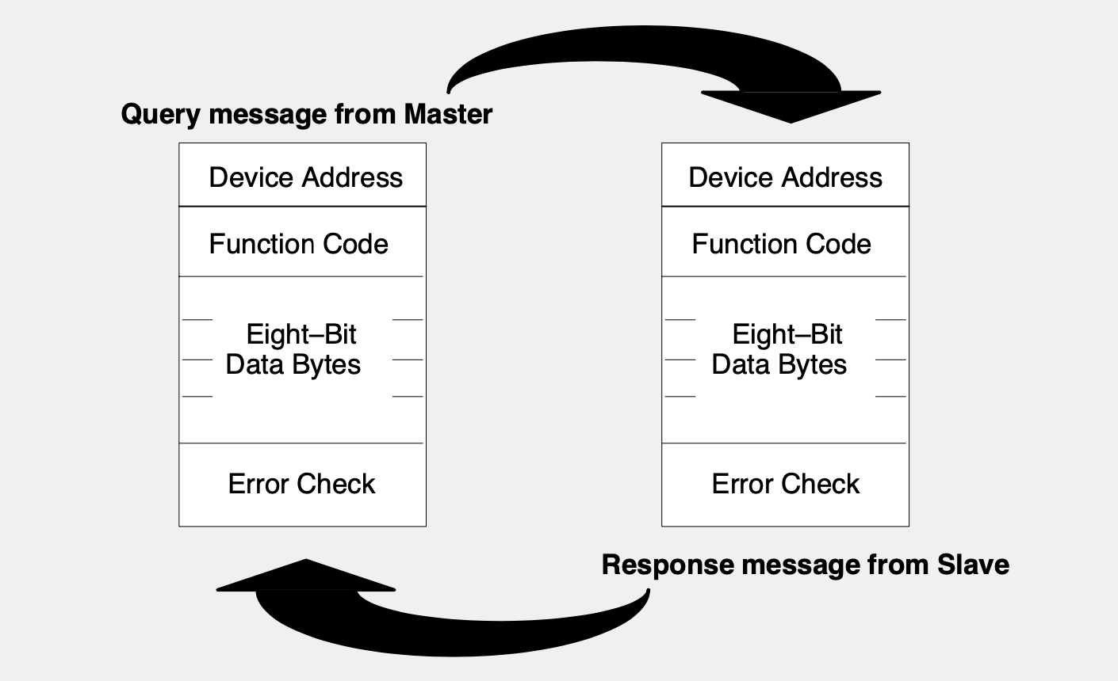
Modbus Query-Response Cycle
Only a master device can originate a message and expects a response from a slave device.
The Query: The function code in the query tells the addressed slave device what kind of action to perform. The data bytes contain any additional information that the slave will need to perform the function.
The Response: If the slave makes a normal response, the function code in the response is an echo of the function code in the query. The data bytes contain the data collected by the slave, such as register values or status. If an error occurs, the function code is modified to indicate that the response is an error response, and the data bytes contain a code that describes the error.

Slide 8
Modbus speed [Need to be updated]
Speed | Transactions / s | Cable Max Length
9600 bit/s | 33.5
115.2 kbit/s | 402 | 1.2 km
10 Mbit/s |  | 12 m
See:
https://pdfserv.maximintegrated.com/en/an/AN3884.pdf
https://www.electricautomationnetwork.com/PDF/PIM/DAO/084B8040_EKD_EIM_Data_Communication_Modbus_RS485_RTU_Product-manual-Service-manual_English_16-01-2017.pdf

Slide 9
Limitation of Modbus
Original commands deprecated
Not optimal for large transfer sizes (e.g. Firmware update)
No automatic attribution of client’s ID
No intrinsic security

Slide 10
Proposed Modbus Configuration
Hardware layer RS-485
Transfer speed >= 115.2 kbit/s
ASCII mode
Start / stop / parity bits (compatible with RS-232 ?)
Bits are transmitted from LSB to MSB
Bytes transmission in big endian
Use minimal number of MUBUS commands via a meta protocol

Slide 11
Used functions
Use a minimal number of function and develop a meta protocol on top of it. Supported functions of original Modbus protocol:
(04) Read Input Registers (16 bits address / number of 16 bits registers), max 125 registers, no broadcast
(16) Preset Multiple Registers (16 bits address / number of 16 bits registers), max 100 registers, slave address or broadcast
All operations of the meta protocol can be implemented with the functions (04) and (16) and with both broadcast and specific slave address

Slide 12
Slave identification (pseudo code)
Each slave takes a random address between 1-33
for I = 1 to 33
Master read the unique serial number (SN) of slave I
If no answer then continue
If answer with valid CRC, assign address I with unique SN
If answer with invalid CRC there is a collision.
If there was any collision, master broadcast the correctly paired ID via a 32bits mask. If a slave not in the mask (bit value of 0 at index), slave should take a new free random address and master will redo previous for section
If no invalid CRC, all slaves are fully assigned

Slide 13
Slave register access
In order to provide a flexible register mechanism, each slave contains a configuration section that is accessible by the master via the R/W functions.
This configuration section is JSON.
It contains, for example, the following option description:
{
"name": "Position_b1",
"type": "uint16",
"min": 0,
"max": 6000,
"scale": 10,
"access": "RW",
"dim": 2,
"unit": "mm",
"address": 768,
"broadcase": "false"
}

Slide 14
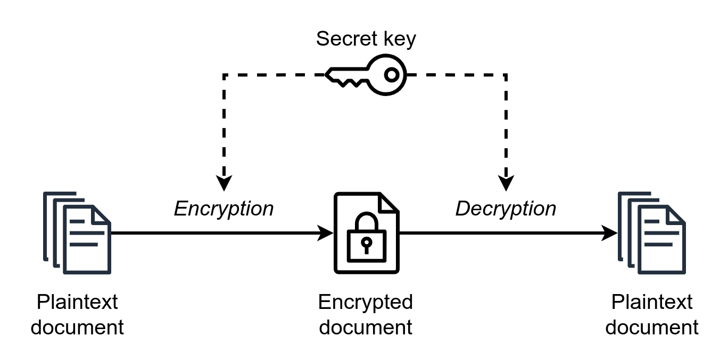
Cyber Security
Modbus protocol is intrinsically unsafe
The idea is to use a Symmetric-key algorithm, the secret key being the SN of the slave to encrypt the option descriptors
If the slave can randomly change address of its registers and generate the encrypted option description, a pirate will not know how to address them.

